Slide 1
PARENTS CLUB
2024-2025
SCHOOL YEAR
Notes:
Car line

Slide 2
Parents' Club Board
President: Jeremy & Vanessa Guerra
Vice-President: Collier Faubion
Co-Treasurer: Ellen Roman
Co-Treasurer: Jaime Brown
Secretary: Angela Nildasio-Ritchie
HR Parent Chair: Laura Kilfoile
HR Parent Co-Chair: Nicole Alvarez
Advisor: Bianca Brink
www.stlawrencecatholicschool.org/parents-club/

Slide 3
What is Parents' Club
The purpose of the Parents’ Club (PC) is to strengthen the partnership between the home and school by participation in the life and activities of the school and provide financial assistance through fundraising efforts. All parents, guardians, faculty, administration, and staff members are an integral part of this group. Parent membership is mandatory.
Parents are the primary and principal educators of their children. As parents at St. Lawrence Catholic School, thereby members of the PC, we pledge to contribute our time, talent, and treasure. Active participation offers families the unique opportunity for fellowship in a Catholic environment.

Slide 4
How do you participate?
COMMIT PROGRAM
Through the COMMIT program (previously the SHARE program), each family can select the option that best meets their needs to reach the family's minimum commitment to our school.
OPTION A: Financial and Service Commitment
$400 by the end of the school year ($200 for single parent families) AND
20 points by the end of the school year (10 points for single parent families)
OPTION B: Financial Commitment only
$800 due no later than September 15th ($400 for single parent families) Volunteering is not required but welcomed
ELECTION FORM IS DUE BY FRIDAY, SEPTEMBER 1, 2024
Notes:
Teachers, teacher aides/assistant and staff members are not required to meet financial or service requirements. If they are a floater, they are required to meet their financial requirements and serve ½ of their service requirements so 10 for a 2 parent household and 5 for single parent household.

Slide 5
Fundraising Recap 2023-2024
Goal for 2023-24: $350,000
Raised: $535,000
Expenditures: $457,000
Funds assisted with:
Annual School Fund- $130,000
Security Film for Top levels: $11,290
Art room renovations(lighting, new tables and painting): $12,150
New computers for computer lab:$50,215
Staff coaching $2,000
Activity Fee- $25,350
Activity Fee is $50/student (max of
$150/family). It covers:
Teacher Thanksgiving Pies
Teacher/Staff Christmas Gift Cards Teacher/Staff
End of Year Gifts Class Projects (i.e., Christmas ornaments, 2nd grade cross)
HR Mom Budget
Notes:
Prizes for spelling bee
Start up costs for Pot O Gold, Gala, etc.
Donuts with Dad/Mornings with Mom, Grandparents Day, Teacher Appreciation Week
FamJam
Mother/Son - Father/Daughter Dance

Slide 6
Fundraising Goals 2024-2025
Projects:
Annual school fund ($130K)
Facility Upgrades
Playground
Bathrooms Upgrade
Security Enhancement
School and/or Classroom needs as they may arise
Goal for 2024-25:
$350,000
Notes:
Studio 3:16
Matt Willhem

Slide 7
Financial Commitment
Pot-O-Gold: 100% towards financial commitment
FunRun: 50% towards financial commitment
Notes:
Auction item donation: 50% of the cost of donated item (with proof of cost) Sponsorship package purchase: 50%
Donation (excluding auction items): 50% Bidding on an auction item: 0%

Slide 8
Service Requirement
The Diocese requires volunteers to take the Safe Environment program training online class and to have a Level II fingerprint background screening done to volunteer. Clearance is good for 5 years. (Details on the Parents' Club Page)
Closest locations to go to for the screenings/fingerprints:
St. Lawrence Catholic School
Christ the King Catholic Church
Our Lady of the Rosary (in Land o Lakes)

Slide 9
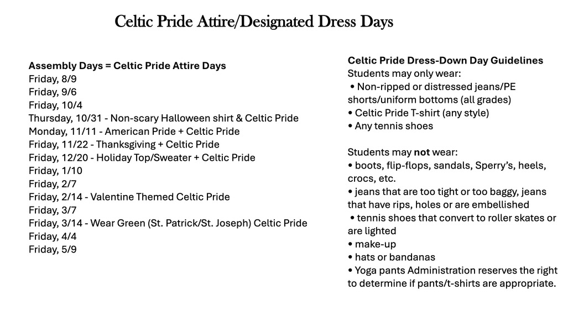
Celtic Pride Days
Dress Down Days:
Assembly days (one Friday per month) & Special Event days as designated below

Slide 10
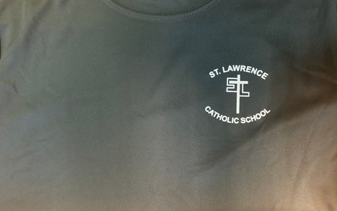
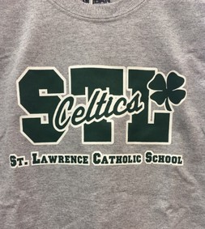
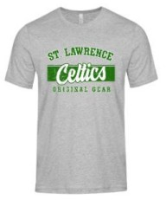
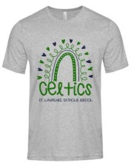
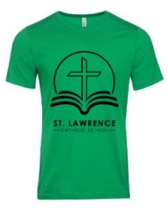
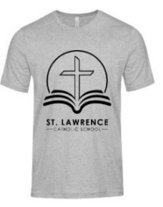
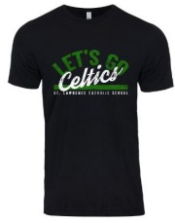
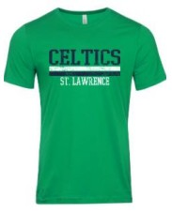
Celtic Pride Days
Approved Spirit Shirts are: Pink STL Strong shirts
Shirts sold through Educational Outfitters (dark gray dri-fit with logo OR STL Celtics t-shirt)
Any of the 6 approved shirts through 1st Place Spirit Wear

Slide 11
Upcoming Events:
August 21st - New Student Bell Ringing–Ceremony will be before 8:30am All School Mass. (EC will have their bell ringing by EC playground)
September 12th - 1st Parents Club meeting: 8:15am in Higgins Hall. Virtual Zoom option will be available again this year.
Donuts with Dad week: week of September 16th
Monday, September 16th - Last names A-L
Tuesday, September 17th - Last names M-Z
Wednesday, September 18th – Dad Mass

Slide 12
Chairs/Clubs
New Family Ambassadors
Fam Jam
Hospitality Committee
HR Parent Chair
HR Parent (individual class)
Marquee Annoucement
Pot of Gold
Trunk o Treat
Thanksgiving Pies
Donuts with Dad
Mornings with Mom
Teacher Appreciation
Fun Run
Dads Club
Summer Bash
Social Media
Field Day
1st Day School Supplies
Points
YAP
YAP Coaches
Scouts Den Leaders
Box Top/Raise Right
Angel Network
Teacher Luncheons
Gala
All Saints Club
Mothers Prayer Group
Notes:
Gala is Saturday, Feb. 11
Great chance to mingle with families and raise money to support our school.
Look for mnore details and opportunities to volunteer

Slide 13
Stay Connected
Meetings: 2nd Thursday of each month from 8:15 a.m. to 9:15 a.m. in Higgins Hall (or virtual)
Parents' Club Instagram: @stlparentsclub
School Instagram: @stlschooltampa School Facebook: /stlschooltampa
Parents' Club Web Page: www.stlawrencecatholicschool.org/par ents-club/
Eblasts: Email contact@stlawrence.org with your first name, last name, preferred email and phone number if you aren't receiving messages.
Service Points: Tracked within x2vol
Inquiries: Monica Piazza stlpoints@gmail.com
Financial Commitment: Tracked within FACTS (renweb)
Inquiries: PCAccounts@stlawrence.org

Slide 14
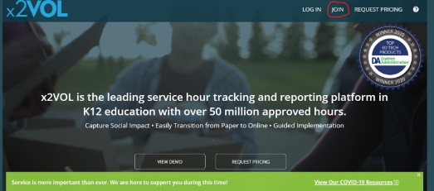
x2VOL
Step-by-step x2VOL walkthrough can be found at:
https://stlawrencecatholicschool.org/parents-club/
Step 1: Visit www.x2vol.com and click "Join"

Slide 15
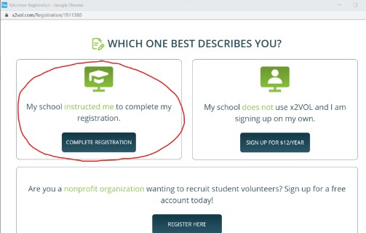
x2VOL
Step 2: Click "Complete Registration" within "My school instructed me to complete by registration"
Step 3: Type "St. Lawrence" and click "Search" - you must put the space between the words

Slide 16
x2VOL
Step 4: Click "St. Lawrence Catholic School Parents Club"
Step 5: Enter YOUR last name and email address (not your student's name)
Step 6: Complete the "Basic Information" within the "Student Registration" section and then click "Proceed." IMPORTANT: You must enter YOUR information, not your student's.

Slide 17
x2VOL
Step 7: OPTIONAL - You may skip the "Interest Gauge " section
Step 8: Complete the "Settings" portion of the "Student Registration" section and then click "Complete Registration" NOTE: Families with two parents/guardians in the same household should select the option with 20 points. Families with parents/guardians in separate households should each select the option for 10 points.

Slide 18
x2VOL
What's next? You will see an "Activation Successful" message meaning your information has been sent to Parents' Club for approval. If you log in immediately, you'll see a note saying your registration is pending approval.
Accounts are reviewed daily so if you still see this message after 48 hours, contact stlpoints@gmail.com

